Slide 1
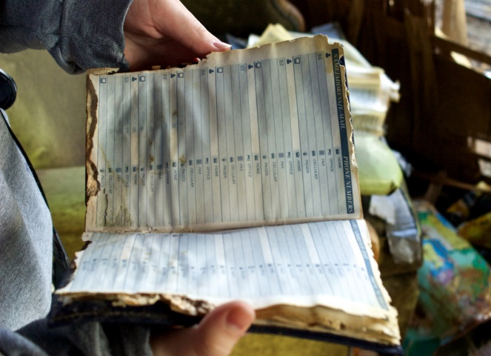


User Info_System

Slide 2

INTRODUCTION
User info system is the system where we can access the information of the users that are currently logged in the system.
This system provides option to add new subscriber details, and edit any details of subscriber or user.
It provides details such as the Name, Age, Date Of Birth, Gender and Address of the subscriber or user.

Slide 3
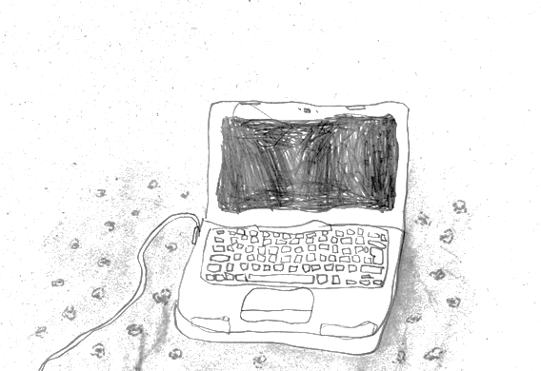
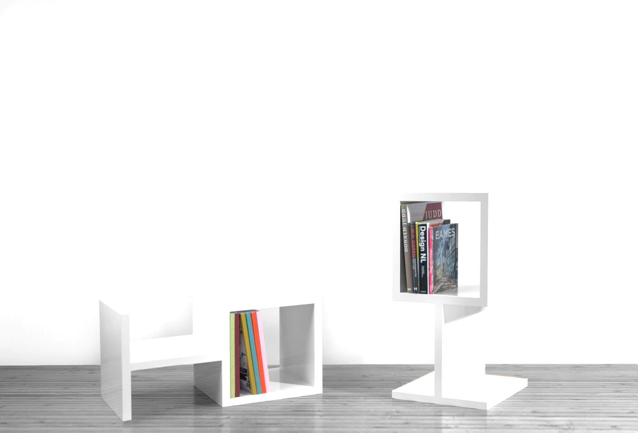

OBJECTIVE
To save the details of users digitally.
To record various details of the user.
To store the user records and retrieve at any time.
To permanently save the user information.

Slide 4


Merits Of Our Program
User friendly interface easier to add and edit the user details.
Sort user details for quick access.
Easier and fast modification.
Easy to learn and use.
Keep the records safe and for future referance.

Slide 5
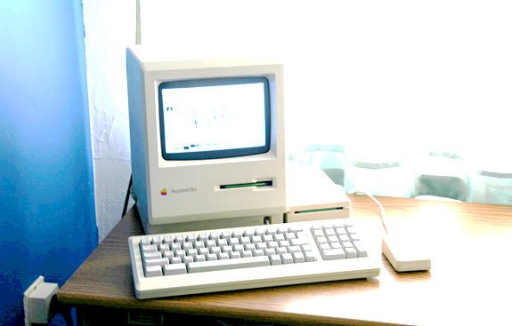

TECHNOLGY REQUIRED
Minimum hardware
Recommendation:
Keyboard
LED/LCD/CRT monitor
PC with Pentium II processor
Hard disk with at least 20 MB free space
Software recommendiation
OS window(window XP, win 7, win 8, win 10, mac)

Slide 6
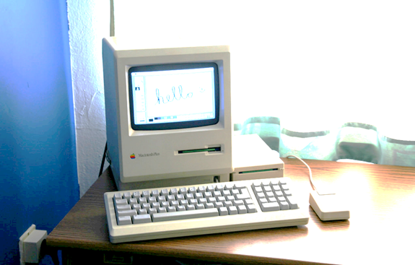



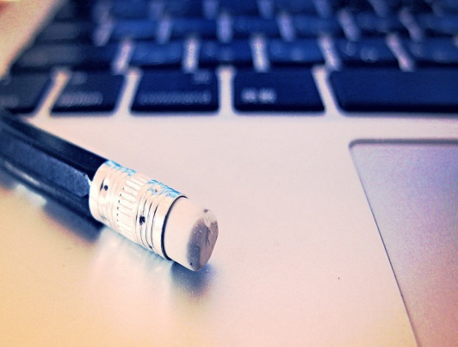
OVERVIEW
An attempt to retrieve the information of users and share them .
Can be used in different analysis purpose.
Developed to meet the needs for different softwares and analysis.
Program to store customer details,phone number, address etc.

Slide 7


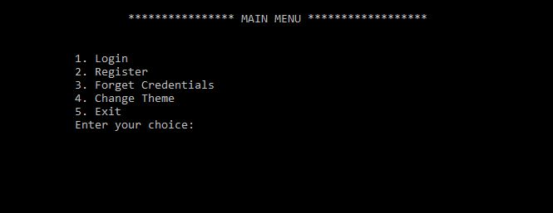
USER INTERFACE
Main Menu

Slide 8

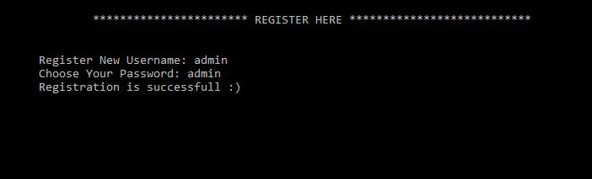
Register

Slide 9
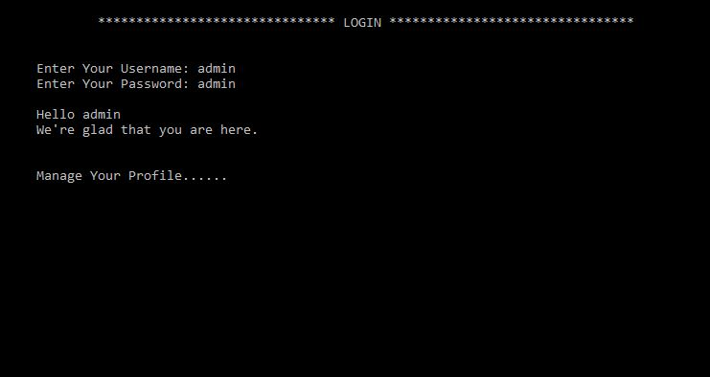
Login

Slide 10
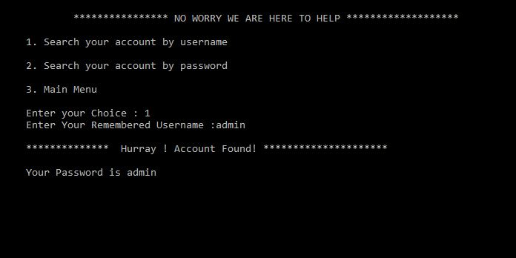
Forget Credentials (Search By Username)

Slide 11
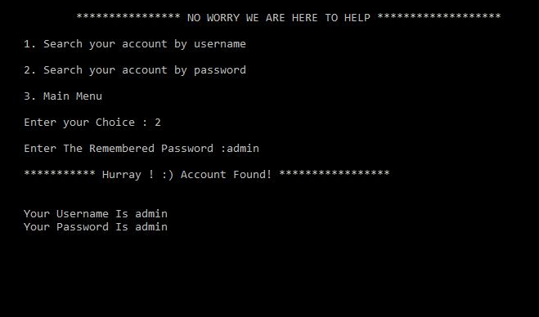
Forget Credentials (Search By Password)

Slide 12
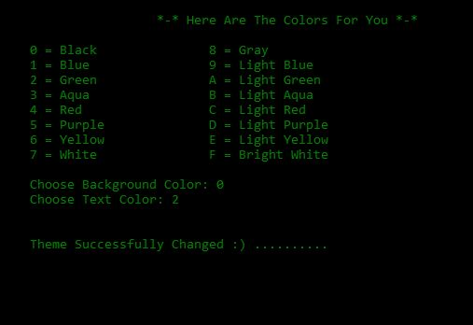
Change Theme

Slide 13
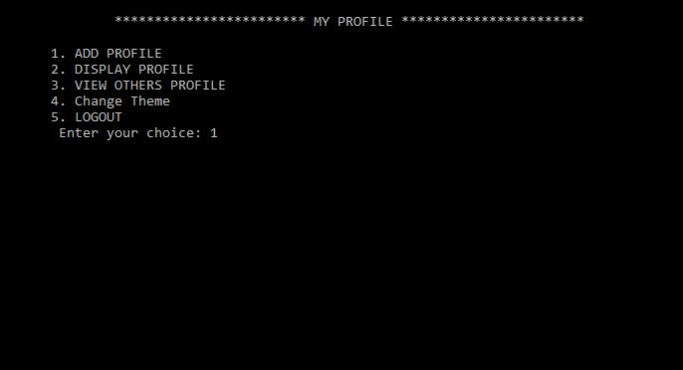
My Profile

Slide 14
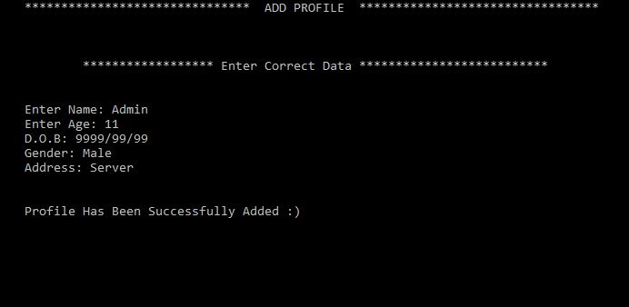
Add Profile

Slide 15
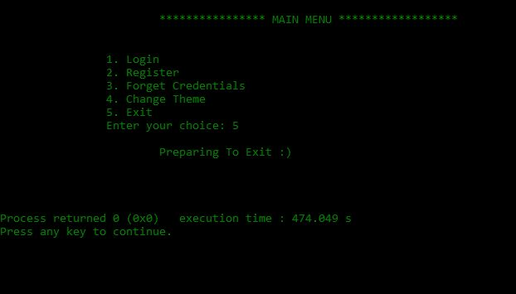
Exit

Slide 16
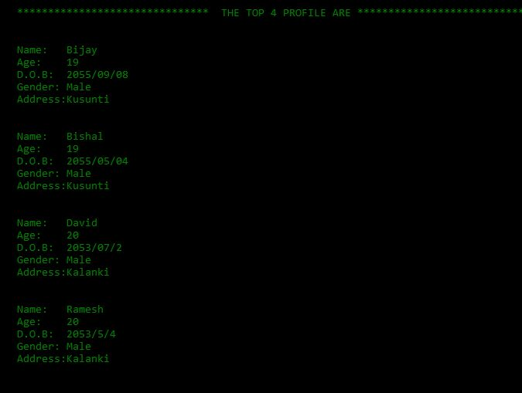
View Others Profile

Slide 17
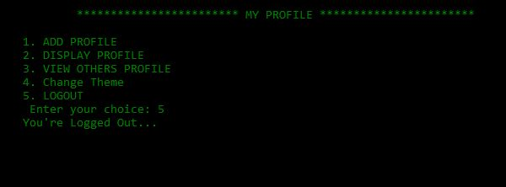
Logout

Slide 18
Logout

Slide 19
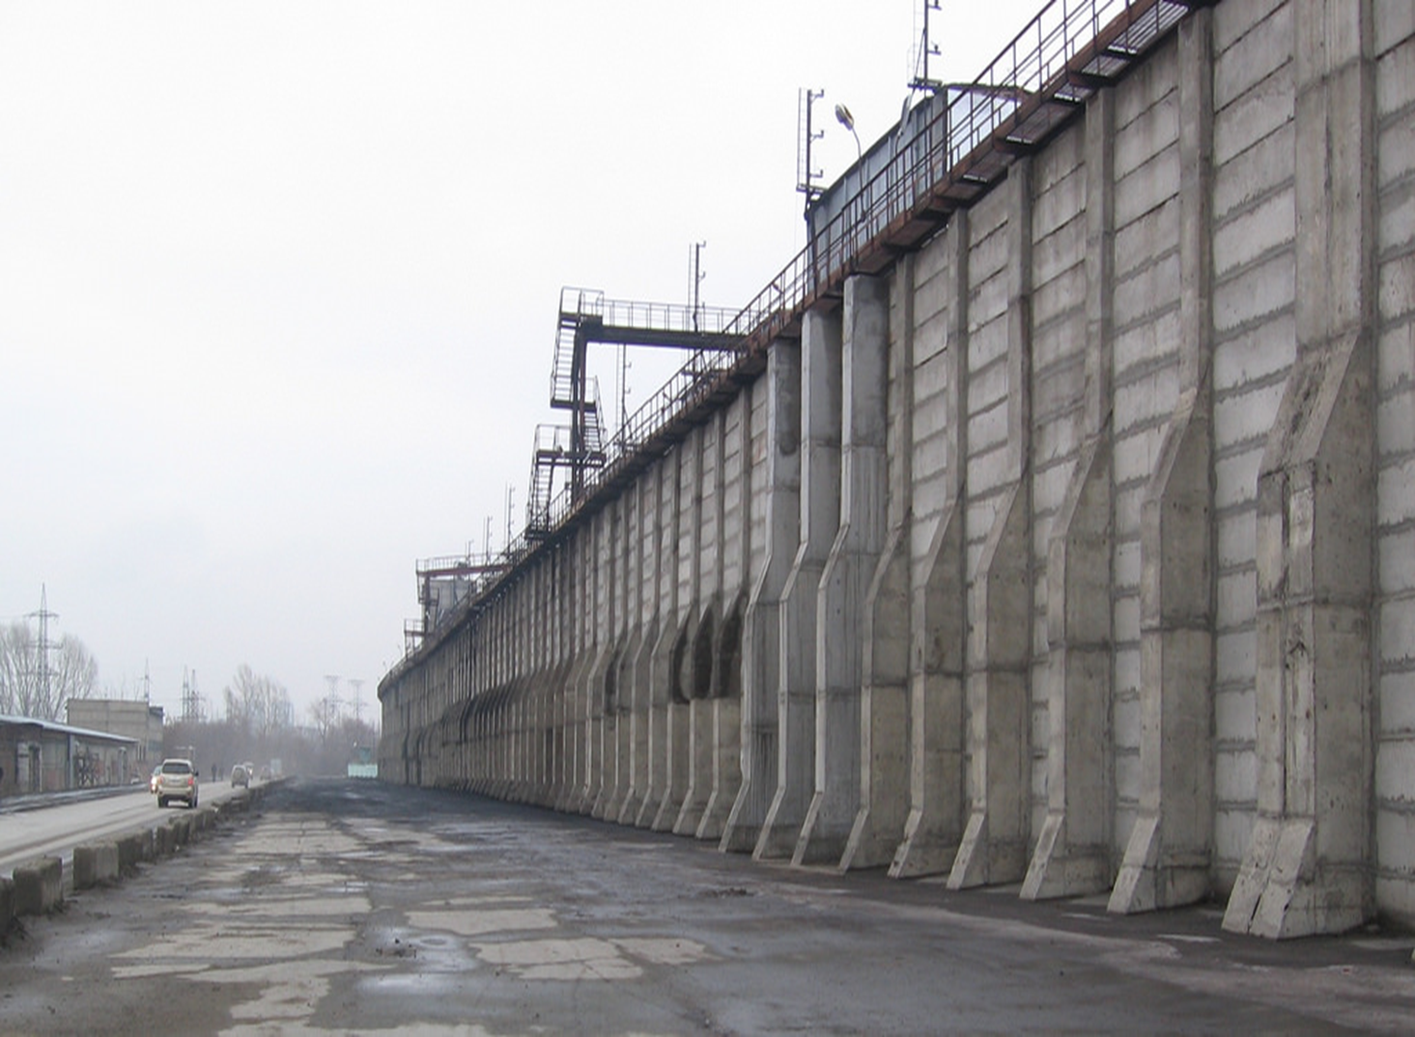
LIMITATION
Printing not supported.
Program might crash if invalid information is entered.
Not compatible for smartphones and web.
Lack of full security of data.

Slide 20
Conclusion
By using this software, user info can be easily be stored digitally.
It reduces time consumption of the user.
Can be used in different organization for acccessing user information
Exceptions are reduced.

Slide 21

Future prospects
Contact sharing support and compatible for web apps.
Advance Graphical User Interface.
Data security.
Printing support.

Slide 22


